Slide 1
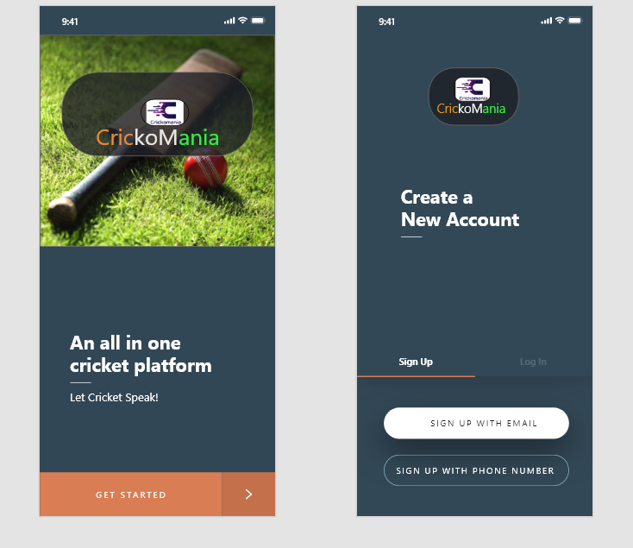
LOGIN

Slide 2
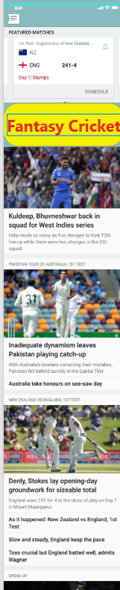
HOME

Slide 3
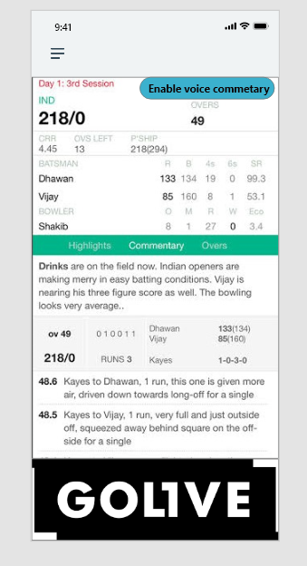
SCORECARD

Slide 4
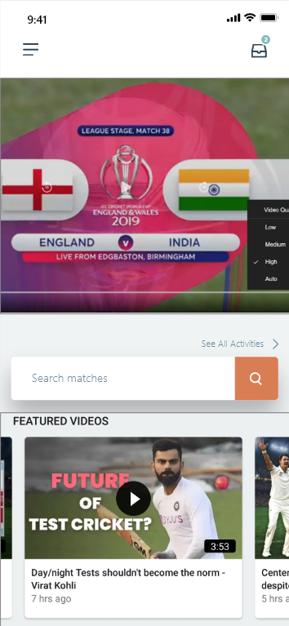
STREAMING PAGE

Slide 5
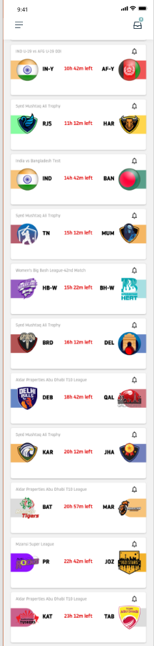
FANTASY LEAGUE

Slide 6
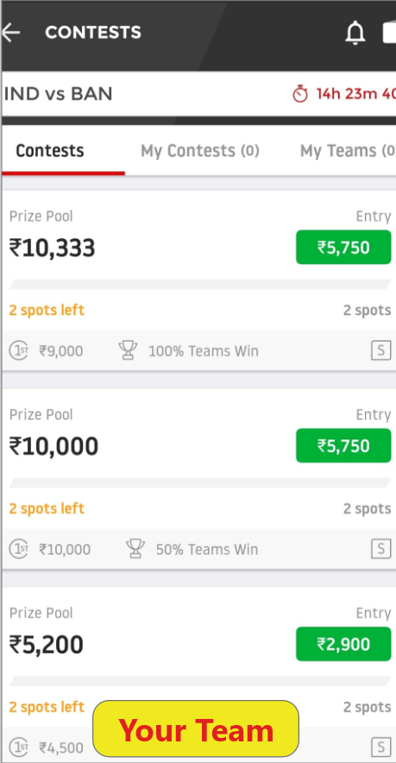
PRICE LAYOUT

Slide 7
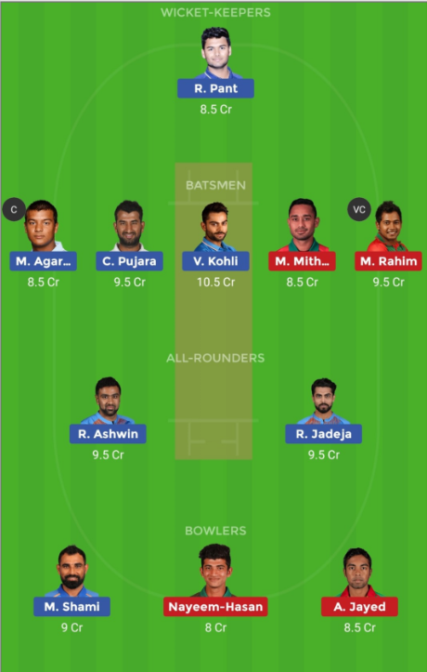
CUSTOMIZE TEAM

Slide 8
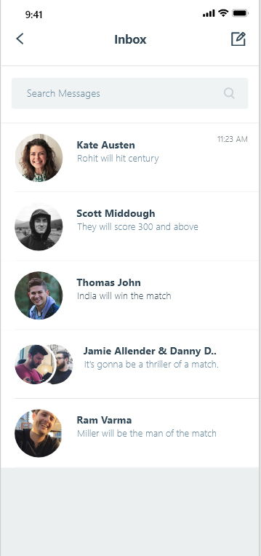
GLOBAL CHAT

Slide 9
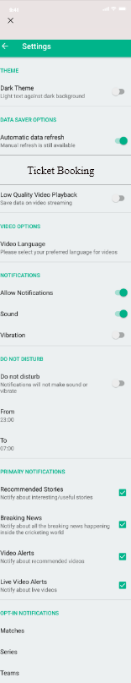
SETTINGS

Slide 10
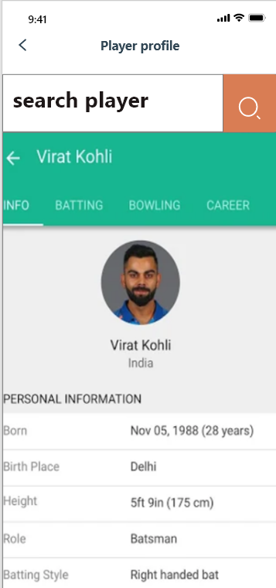
PLAYER PROFILE

Slide 11
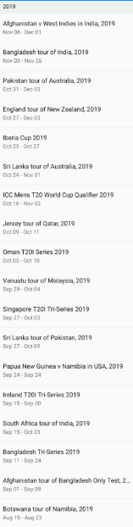
ARCHIVES

Slide 12
Thankyou...

